Slide 1
Python Project
Project Name – Online Book Store
Group members – 1.Jayansh Goyal - 2017KUCP1042
2.Manoj Bairwa - 2017KUCP1044
3.Salman Khan - 2017KUCP1052
Project Mentor – Mr. Mayank Jain

Slide 2
Tools Used :- Frontend Portion:-
DESIGINING
HTML
CSS

Slide 3
Tools Used :- Backend Portion:-
DEGINING
Google books
api
Sqlite
Python
Flask

Slide 4
Tables in database :-
1.users
2.comments
3.userbooks
CREATE TABLE IF NOT EXISTS users(id integer primary key ,username text not null, password text not null )
CREATE TABLE IF NOT EXISTS userbooks(id integer primary key ,username text ,password text,bookid integer, isbn integer )
CREATE TABLE IF NOT EXISTS comments(bookid integer,comment text not null)

Slide 5
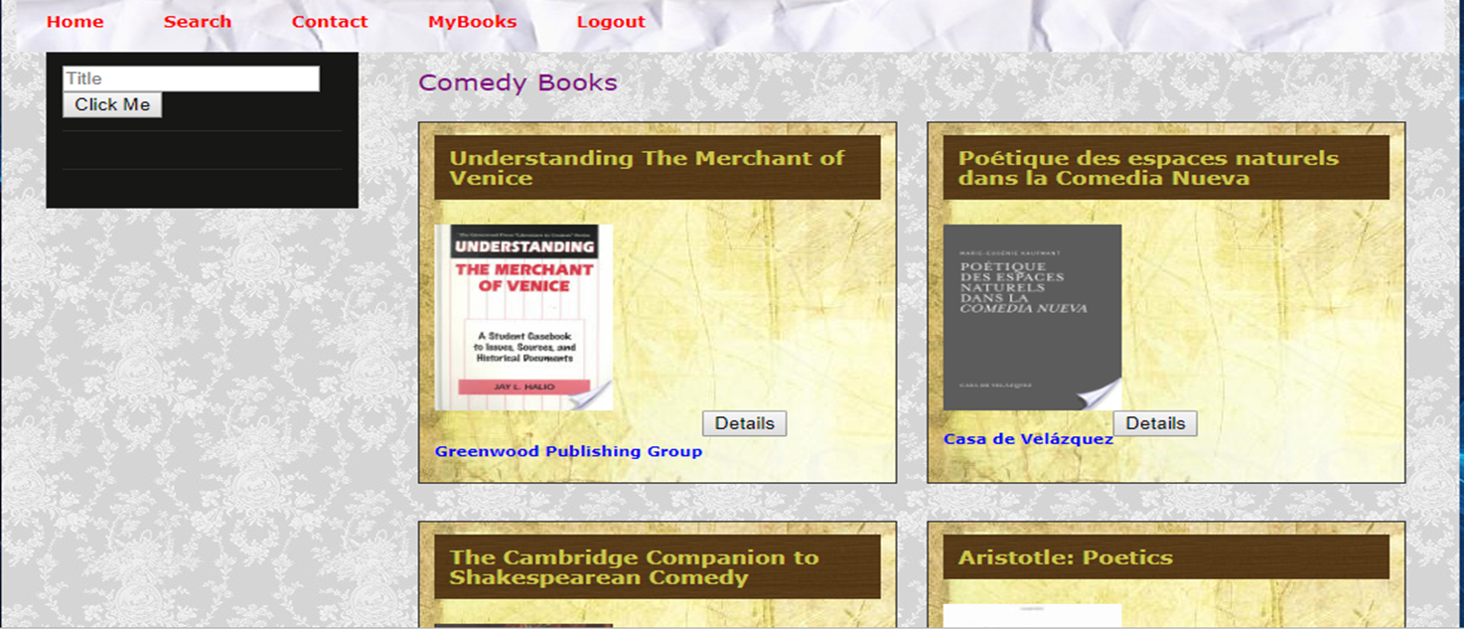
Home - Page
In this page , user will find books of different categories. He can also read about all that books.

Slide 6
Facilities :-
1. Searching:– User can search for specific books on the website.
Ex- If you search Helen keller books.

Slide 7
2. More Details About Books :
You can read book by clicking the more details button .

Slide 8
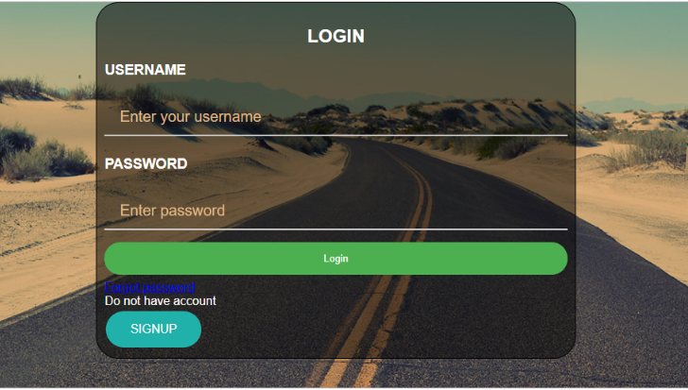
Login PagE :– User Can Login by filling out the fields in login page.

Slide 9
Sign-up Page :- For new users.

Slide 10
Forgot password :- if user forget their password then for conformation enter username.

Slide 11
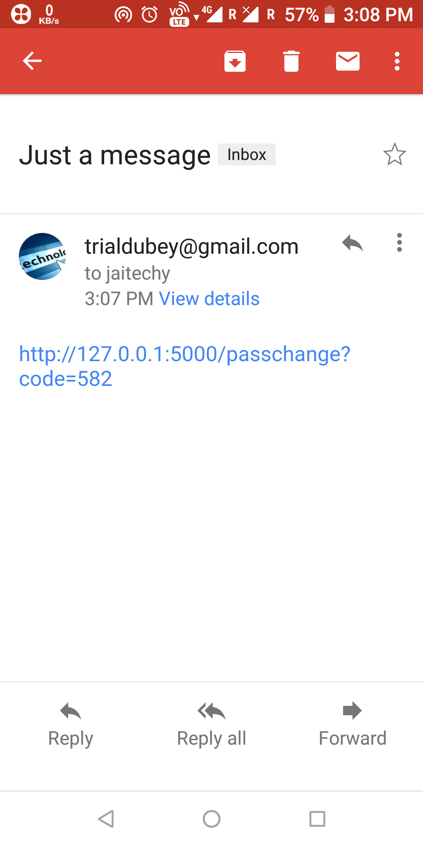
Link send on gmail-id of users :-
If user wants to reset their password then ,
He/she has to click on the link sent on their e-mail . Without this they will not be able to reset password.
This is great feature which enhanced user
account security.

Slide 12
Comment - section:– People shares their ideas about books . So that other user can know about that book.

Slide 13
Contact with developers :– In case of any problem , user can contact with developers.

Slide 14
Personalization list :–User can make a separate list of his books which he may likes according to his interest, this gives user personalized experience.

Slide 15
references :–
Google Books
Stackoverflow.com
Flask Documentation

Slide 16
HoPE YOU LIKE!
Thank you

